Slide 1
Mrs. Amanda Visokay
Language Arts
September 2020

Slide 2
I love being a teacher, it is my dream job.
This is my tenth year teaching eighth grade, and I also taught on the college level for ten years, at Middlesex County College. I love reading and writing, so Language Arts is my specialty.
I’d love to write my own book, one day. I’m also a mom, of three middle schoolers, which informs my perspective.

Slide 3
The best way to reach me is via: email, which I check all the time. I’ll always get back to you in a timely manner. We can also arrange a phone conversation using Google Voice.
My email is:
amanvisokay@paps.net
You can also read more on my teacher webpage on the school website.

Slide 4
Your teens are already logged into my Google classrooms, through codes they were given in the summer.
I do all my communicating with my students through Google classroom. Our meets occur every school day during their scheduled class time. They are expected to be on time every day. Attendance is recorded. If they are having tech issues during the meet - they need to communicate via: the chat or Google comments, immediately. They need to be present the whole meet.

Slide 5
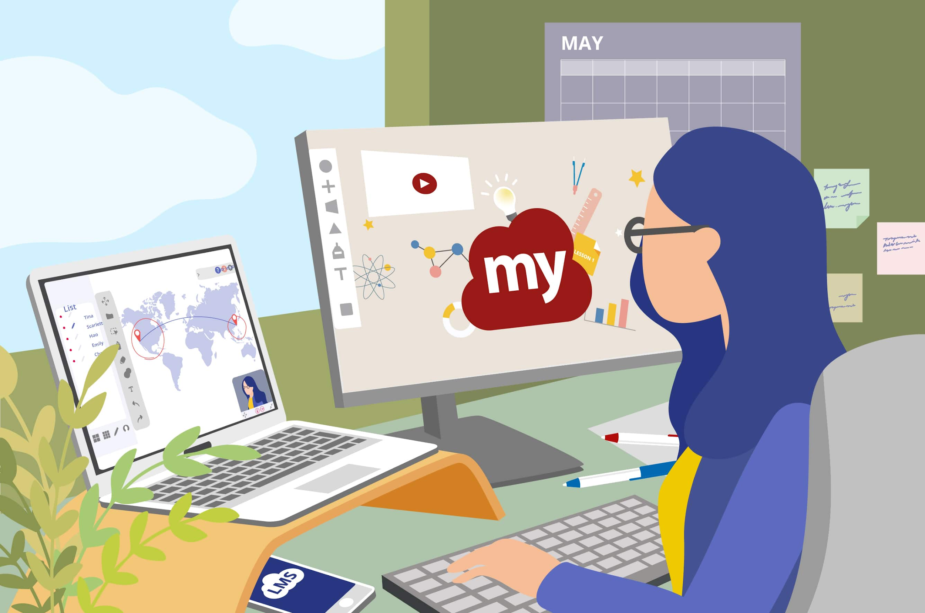
While we have to work remotely, we’re doing a great job making it work!
During class time, your teens need to be logged in to the Google Meet, have their cameras on, and be ready to answer when called upon. They are responsible for completing all work assigned during class. Their classwork/participation grade will be reduced if their camera is off at all during class, or they aren’t there when called upon.

Slide 6
Your teen’s grade will be made up of:
Homework assignments (given some nights Monday-Thursday)
Quizzes and tests
Long term writing pieces
Classwork assignments and participation
Do Now grades daily
Oral presentations
Projects involving art and creativity

Slide 7
The course work for this class includes:
Novel based instruction to teach reading skills
Writers’ Workshop to teach narrative writing
(memoir), persuasive writing (argumentative
essay and speech), literary analysis (proving a multifaceted
thesis), poetry, and letter writing
Public speaking
Examination of social issues and current events
Exposure to diverse role models
Project based learning involving choice
Independent reading and response to text

Slide 8
I am a HUGE bookworm! When they closed public libraries - I was devastated! I want your teens to connect with reading - I work so hard at helping them find the “right” book (especially when we’re back at school). Please encourage them to read, talk about reading, take them to the library or bookstore. Encourage them to read!

Slide 9
Perth Amboy Public Schools
All-Remote Learning Guidelines
“Cameras must be on and students must remain visible during the entire remote instructional period. For example, no avatars are allowed and cameras should not be pointed to the ceiling”
Students must “remain online and logged into their Google Meet while working independently on class assignments”
“Use Google Meet neutral screen backgrounds to protect the privacy of their homes”
“Adhere and comply with all applicable Board policies governing the use of technology”
“Follow the Student Code of Conduct at all times. School administration will ensure follow ups and supports take
place as needed by: … phone calls… counseling support … home school liason support… parental support”
Parents will “preclude themselves from recording any session or posting any session to any website or social media site”
“If it would not be acceptable in the physical classroom, then it is not acceptable in the virtual setting”
“Parents are not to interact with the class”

Slide 10
Simple Class Rules
Show respect for others - do not talk when others are speaking (stay on mute)
Show respect for others’ views - you may not agree, but others need to feel safe owning how they feel and expressing it
Show respect for yourself - the way you carry yourself - and the way you dress on camera
Profanity is never allowed in this class
The chat feature is NOT to be used during the actual lesson - you are to be silent digitally - when the teacher is teaching… if you have a question you can raise your virtual hand
Keep “chatting” to a minimum - just like in class, be cognizant of bothering others with your chatting
Be authentic and honest about all the work you do. Cheating/plagiarizing/getting work from the internet - will not be tolerated. Work that is not authentic will receive a grade of zero.
Be responsible for your learning - ask for help when needed. Ask questions when you need clarification. Get all of your work done on time, and create high quality work.
Dive into learning - soak up the material, and do outside research to learn more about interesting ideas and topics. I encourage you to learn outside the class time. Share with us what you learn.
Make reading a way of life. Books will open up worlds to you.

Slide 11
There are procedures in our classroom, which will make it a happy and safe place for you to learn and grow, once we are back

Slide 12
Discussion is so important to class
Everyone deserves a chance to share
Everyone’s views are welcome
They can feel safe here
They MUST show respect by being quiet when anyone else has the floor

Slide 13
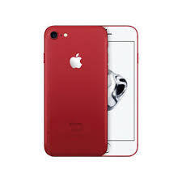
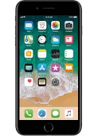
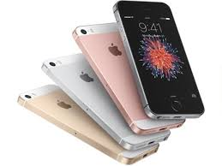
Cell phones are not welcome here in any way, shape, or form
But, the good news is … they are welcome here …
…in every way, shape, and form

Slide 14
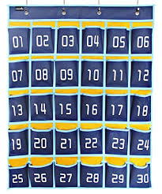
When they walk in the door of 310 – their phones will go in the pockets they are assigned.
Right before they leave, they will retrieve their phone. They will become accustomed to not having it in here – and it will actually free them, in a way.
They will become a more astute learners, without its company.

Slide 15
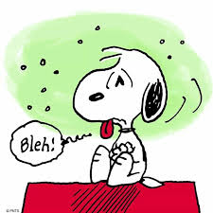
Making Up Work When They are Absent …
When they are absent, they are responsible to talk to the teacher about the work they missed, and to make it up. The responsibility is on them. This applies at home, as well.

Slide 16
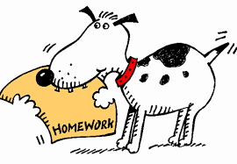
Homework
Homework assignments will be given a few times a week.
They will never receive Friday homework
It is expected that they complete all of the homework assignments given
They will receive full credit (100), half credit (50), or 0 on homework – there are no other choices
It is so important that they learn to be strong students - they owe themselves that

Slide 17
Feel free to reach out, for any questions, concerns, or just to keep me in the loop.
We are a team - working in the best interest of your teen - helping him/her to learn, grow, prosper. I am here to support your teen, and to work with you.

Slide 18
Open the World to Them
I love working with your teenagers. It is so hard to be a teen … and oftentimes they feel like no one understands them.
I love hearing their views. I love seeing them as the special unique adolescents they are – and I respect them. I will encourage them to find their magic, to develop their gifts, to reach for the whole world. I believe they can create whatever future they dream of. I will encourage them to the ends of the Earth. I will tell them the truth. I will believe in them. I will push them to grow. They may not like it … but when we’re done, they’ll thank me for pushing them. I will support them. I will have their back. I will listen. When they show me respect in class, rise to my expectations, I will open the world to them. We will have an incredible year together. I will grow attached. I will be filled with pride on graduation day. I will cry.

